Slide 1

Chapter 7 – Arrays and Array Lists

Slide 2

Chapter Goals
To collect elements using arrays and array lists
To use the enhanced for loop for traversing arrays and array lists To learn common algorithms for processing arrays and array lists To work with two-dimensional arrays
To understand the concept of regression testing

Slide 3
Arrays
An array collects a sequence of values of the same type. Create an array that can hold ten values of type double:
new double[10]
The number of elements is the length of the array The new operator constructs the array
The type of an array variable is the type of the element to be stored, followed by
[].
To declare an array variable of type double[]
double[] values;
To initialize the array variable with the array:
double[] values = new double[10];
By default, each number in the array is 0
You can specify the initial values when you create the array
double[] moreValues = { 32, 54, 67.5, 29, 35, 80, 115, 44.5, 100, 65 };

Slide 4
Arrays
To access a value in an array, specify which “slot” you want to use
use the [] operator
values[4] = 35;
The “slot number” is called an index. Each slot contains an element.
Individual elements are accessed by an integer index i, using the notation
array[i].
An array element can be used like any variable.
System.out.println(values[4]);

Slide 5
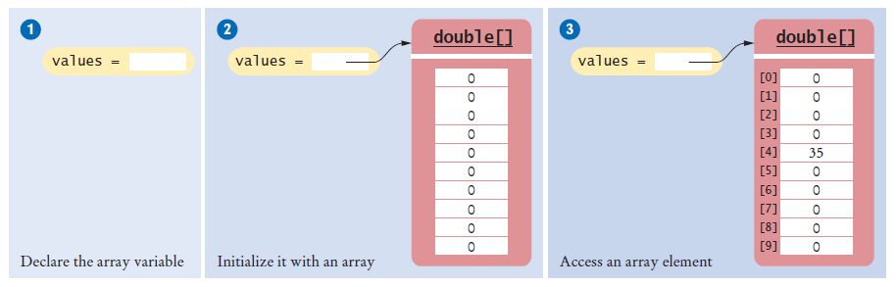
Arrays
Figure 1 An Array of Size 10

Slide 6
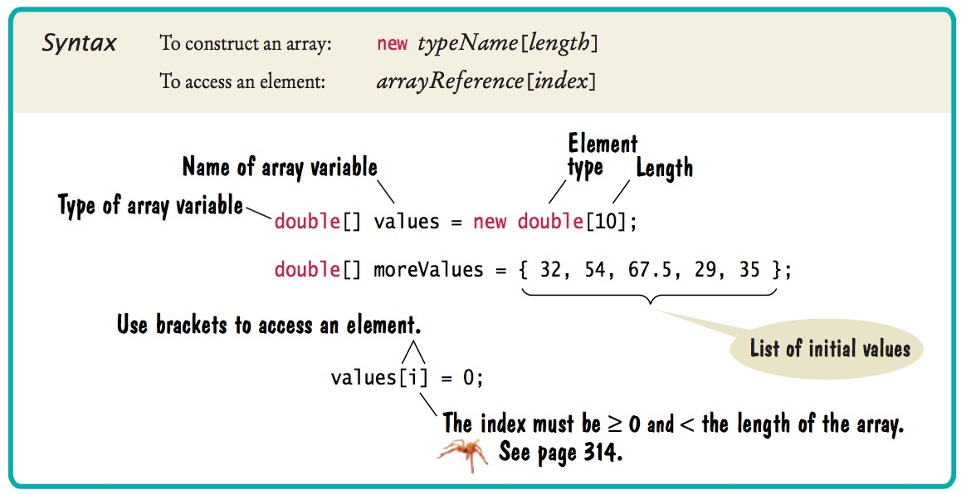
Syntax 7.1 Arrays

Slide 7

Arrays
The elements of arrays are numbered starting at 0.
The following declaration creates an array of 10 elements:
double[] values = new double[10];
An index can be any integer ranging from 0 to 9. The first element is values[0]
The last element is values[9]
An array index must be at least zero and less than the size of the array.
Like a mailbox that is identified by a box number, an array element is identified by an index.

Slide 8
Arrays - Bounds Error
A bounds error occurs if you supply an invalid array index. Causes your program to terminate with a run-time error.
Example:
double[] values = new double[10]; values[10] = value; // Error
values.length yields the length of the values array. There are no parentheses following length.

Slide 9
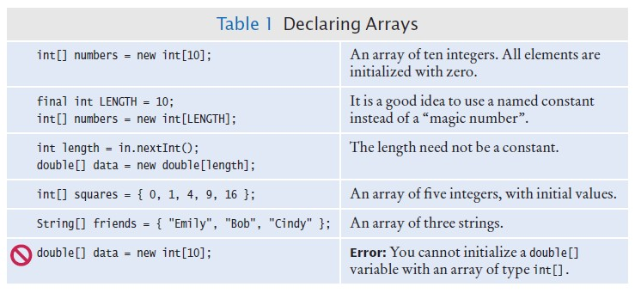
Declaring Arrays

Slide 10
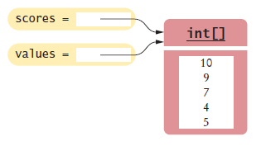
Array References
An array reference specifies the location of an array.
Copying the reference yields a second reference to the same array.
When you copy an array variable into another, both variables refer to the same array
int[] scores = { 10, 9, 7, 4, 5 };
int[] values = scores; // Copying array reference
You can modify the array through either of the variables:
scores[3] = 10; System.out.println(values[3]); // Prints 10
Figure 2 Two Array Variables Referencing the Same Array

Slide 11
Using Arrays with Methods
Arrays can occur as method arguments and return values. An array as a method argument
public void addScores(int[] values)
{
for (int i = 0; i < values.length; i++)
{
totalScore = totalScore + values[i];
}
}
To call this method
int[] scores = { 10, 9, 7, 10 }; fred.addScores(scores);
A method with an array return value
public int[] getScores()

Slide 12
Partially Filled Arrays
Array length = maximum number of elements in array. Usually, array is partially filled
Define an array larger than you will need
final int LENGTH = 100;
double[] values = new double[LENGTH];
Use companion variable to keep track of current size: call it currentSize

Slide 13
Partially Filled Arrays
A loop to fill the array
int currentSize = 0;
Scanner in = new Scanner(System.in); while (in.hasNextDouble())
{
if (currentSize < values.length)
{
values[currentSize] = in.nextDouble(); currentSize++;
}
}
At the end of the loop, currentSize contains the actual number of elements in the array.
Note: Stop accepting inputs when currentSize reaches the array length.

Slide 14
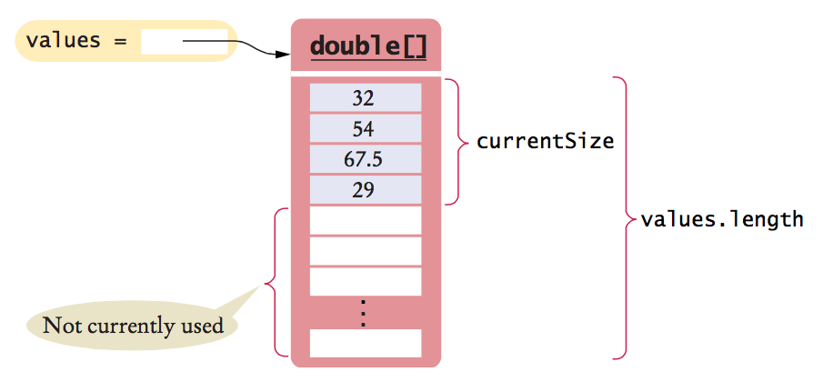
Partially Filled Arrays
Figure 3 A partially-filled array

Slide 15

Partially Filled Arrays
To process the gathered array elements, use the companion variable, not the array length:
for (int i = 0; i < currentSize; i++)
{
System.out.println(values[i]);
}
With a partially filled array, you need to remember how many elements are filled.

Slide 16
Self Check 7.1
Declare an array of integers containing the first five prime numbers
Answer:
int[] primes = { 2, 3, 5, 7, 11 };

Slide 17
Self Check 7.2
Assume the array primes has been initialized as described in Self Check 1. What does it contain after executing the following loop?
for (int i = 0; i < 2; i++)
{
primes[4 - i] = primes[i];
}
Answer: 2, 3, 5, 3, 2

Slide 18
Self Check 7.3
Assume the array primes has been initialized as described in Self Check 1. What does it contain after executing the following loop?
for (int i = 0; i < 5; i++)
{
primes[i]++;
}
Answer: 3, 4, 6, 8, 12

Slide 19
Self Check 7.4
Given the declaration
int[] values = new int[10];
write statements to put the integer 10 into the elements of the array values with the lowest and the highest valid index.
Answer:
values[0] = 10;
values[9] = 10;
or better: values[values.length - 1] = 10;

Slide 20
Self Check 7.5
Declare an array called words that can hold ten elements of type String.
Answer: String[] words = new String[10];

Slide 21
Self Check 7.6
Declare an array containing two strings, "Yes", and "No".
Answer: String[] words = { "Yes", "No" };

Slide 22
Self Check 7.7
Can you produce the output on page 308 without storing the inputs in an array, by using an algorithm similar to the algorithm for finding the maximum in Section 6.7.5?
Answer: No. Because you don’t store the values, you need to print them when you read them. But you don’t know where to add the <= until you have seen all values.

Slide 23
Self Check 7.8
Declare a method of a class Lottery that returns a combination of n numbers. You don’t need to implement the method.
Answer:
public class Lottery
{
public int[] getCombination(int n) { . . . }
. . .
}

Slide 24
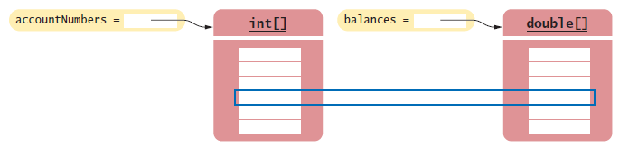
Make Parallel Arrays into Arrays of Objects
Don't do this
int[] accountNumbers; double[] balances;
Don't use parallel arrays
Figure 4 Avoid Parallel Arrays

Slide 25
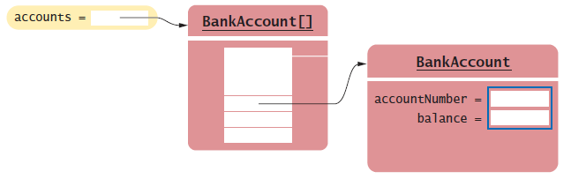
Make Parallel Arrays into Arrays of Objects
Avoid parallel arrays by changing them into arrays of objects:
BankAccount[] accounts;
Figure 5 Reorganizing Parallel Arrays into an Array of Objects

Slide 26
The Enhanced for Loop
You can use the enhanced for loop to visit all elements of an array. Totaling the elements in an array with the enhanced for loop
double[] values = . . .; double total = 0;
for (double element : values)
{
total = total + element;
}
The loop body is executed for each element in the array values. Read the loop as “for each element in values.”
Traditional alternative:
for (int i = 0; i < values.length; i++)
{
double element = values[i]; total = total + element;
}

Slide 27

The Enhanced for Loop
Not suitable for all array algorithms.
Does not allow you to modify the contents of an array. The following loop does not fill an array with zeros:
for (double element : values)
{
element = 0; // ERROR: this assignment does not modify array elements
}
Use a basic for loop instead:
for (int i = 0; i < values.length; i++)
{
values[i] = 0; // OK
}
Use the enhanced for loop if you do not need the index values in the loop body.
The enhanced for loop is a convenient mechanism for traversing all elements in a collection.

Slide 28
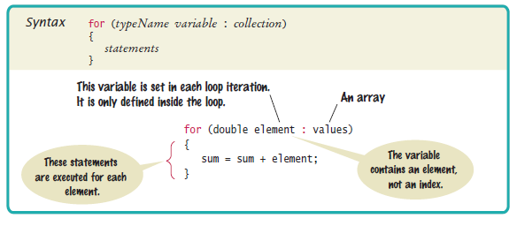
Syntax 7.2 The Enhanced “for” Loop

Slide 29
Self Check 7.9
What does this enhanced for loop do?
int counter = 0;
for (double element : values)
{
if (element == 0) { counter++; }
}
Answer: It counts how many elements of values are zero.

Slide 30
Self Check 7.10
Write an enhanced for loop that prints all elements in the array values.
Answer:
for (double x : values)
{
System.out.println(x);
}

Slide 31
Self Check 7.11
Write an enhanced for loop that multiplies all elements in a double[] array named factors, accumulating the result in a variable named product.
Answer:
double product = 1;
for (double f : factors)
{
product = product * f;
}

Slide 32
Self Check 7.12
Why is the enhanced for loop not an appropriate shortcut for the following basic for loop?
for (int i = 0; i < values.length; i++) { values[i] = i * i; }
Answer: The loop writes a value into values[i]. The enhanced for loop does not have the index variable i.

Slide 33
Common Array Algorithm: Filling
Fill an array with squares (0, 1, 4, 9, 16, ...):
for (int i = 0; i < values.length; i++)
{
values[i] = i * i;
}

Slide 34
Common Array Algorithm: Sum and Average
To compute the sum of all elements in an array:
double total = 0;
for (double element : values)
{
total = total + element;
}
To obtain the average:
double average = 0;
if (values.length > 0) { average = total / values.length; }

Slide 35

Common Array Algorithm: Maximum or Minimum
Finding the maximum in an array
double largest = values[0];
for (int i = 1; i < values.length; i++)
{
if (values[i] > largest)
{
largest = values[i];
}
}
The loop starts at 1 because we initialize largest with values[0].
Finding the minimum: reverse the comparison.
These algorithms require that the array contain at least one element.

Slide 36

Common Array Algorithm: Element Separators
When you display the elements of an array, you usually want to separate them:
Ann | Bob | Cindy
Note that there is one fewer separator than there are elements
Print the separator before each element except the initial one (with index 0):
for (int i = 0; i < names.size(); i++)
{
if (i > 0)
{
System.out.print(" | ");
}
System.out.print(names.value[i]);
}
To print five elements, you need four separators.

Slide 37
Common Array Algorithm: Linear Search
To find the position of an element:
Visit all elements until you have found a match or you have come to the end of the array
Example: Find the first element that is equal to 100
int searchedValue = 100; int pos = 0;
boolean found = false;
while (pos < values.length && !found)
{
if (values[pos] == searchedValue)
{
found = true;
}
else
{
pos++;
}
}
if (found) { System.out.println("Found at position: " + pos); } else { System.out.println("Not found"); }

Slide 38

Common Array Algorithm: Linear Search
This algorithm is called a linear search.
A linear search inspects elements in sequence until a match is found.
To search for a specific element, visit the elements and stop when you encounter the match.

Slide 39
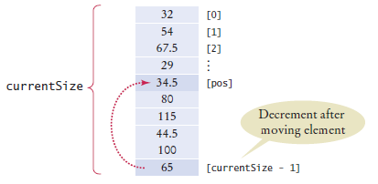
Common Array Algorithm: Removing an Element
Problem: To remove the element with index pos from the array values with number of elements
currentSize.
Unordered
Overwrite the element to be removed with the last element of the array.
Decrement the currentSize variable.
values[pos] = values[currentSize - 1]; currentSize--;
Figure 6 Removing an Element in an Unordered Array

Slide 40
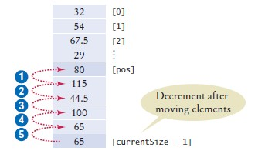
Common Array Algorithm: Removing an Element
Ordered array
Move all elements following the element to be removed to a lower index.
Decrement the variable holding the size of the array.
for (int i = pos + 1; i < currentSize; i++)
{
values[i - 1] = values[i];
}
currentSize--;
Figure 7 Removing an Element in an Ordered Array

Slide 41
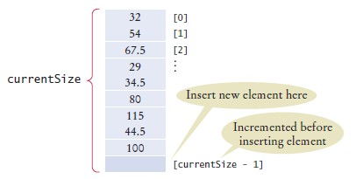
Common Array Algorithm: Inserting an Element
If order does not matter
Insert the new element at the end of the array.
Increment the variable tracking the size of the array.
if (currentSize < values.length)
{
currentSize++
values[currentSize - 1] = newElement;
}
Figure 8 Inserting an Element in an Unordered Array

Slide 42
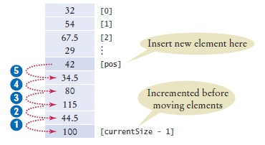
Common Array Algorithm: Inserting an Element
If order matters
Increment the variable tracking the size of the array.
Move all elements after the insertion location to a higher index.
Insert the element .
if (currentSize < values.length)
{
currentSize++;
for (int i = currentSize - 1; i > pos; i--)
{
values[i] = values[i - 1];
}
values[pos] = newElement;
}
Figure 9 Inserting an Element in an Ordered Array

Slide 43

Common Array Algorithm: Swapping Elements
To swap two elements, you need a temporary variable.
We need to save the first value in the temporary variable before replacing it.
double temp = values[i]; values[i] = values[j];
Now we can set values[j] to the saved value.
values[j] = temp;

Slide 44
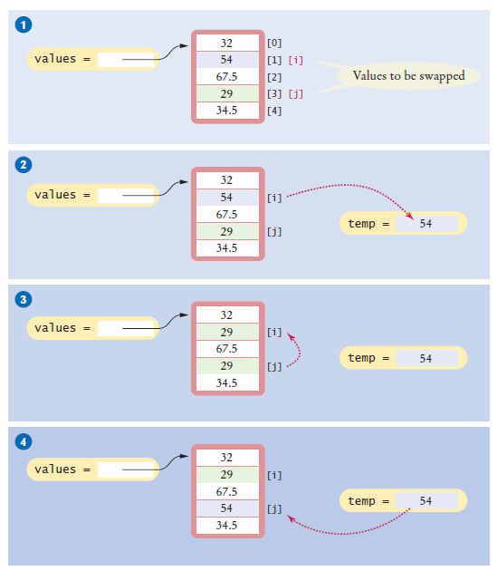
Common Array Algorithm: Swapping Elements
Figure 10 Swapping Array Elements

Slide 45
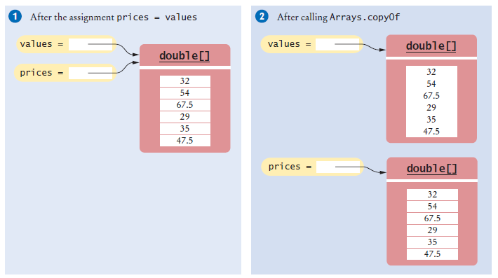
Common Array Algorithm: Copying an Array
Copying an array variable yields a second reference to the same array:
double[] values = new double[6];
. . . // Fill array
double[] prices = values;
To make a true copy of an array, call the Arrays.copyOf method:
double[] prices = Arrays.copyOf(values, values.length);
Figure 11 Copying an Array Reference versus Copying an Array
To use the Arrays class, you need to add the following statement to the top of your program
import java.util.Arrays;

Slide 46
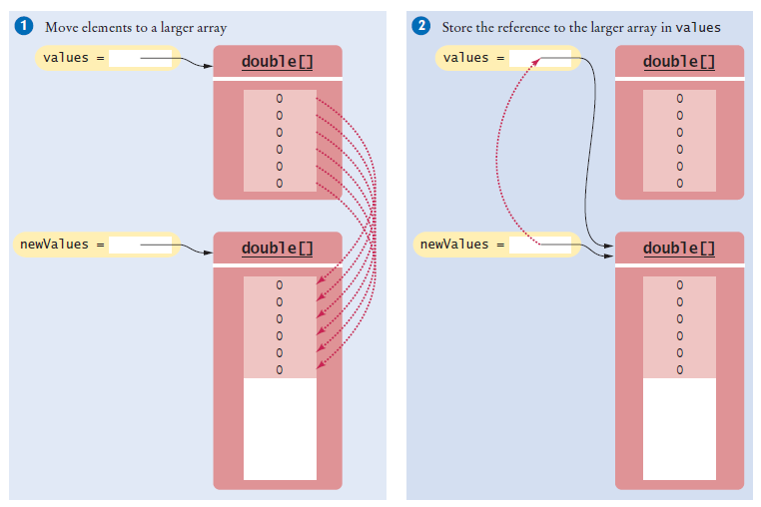
Common Array Algorithm: Growing an Array
To grow an array that has run out of space, use the Arrays.copyOf method: To double the length of an array
double[] newValues = Arrays.copyOf(values, 2 * values.length); values = newValues;
Figure 12 Growing an Array

Slide 47
Reading Input
To read a sequence of arbitrary length:
Add the inputs to an array until the end of the input has been reached. Grow when needed.
double[] inputs = new double[INITIAL_SIZE]; int currentSize = 0;
while (in.hasNextDouble())
{
// Grow the array if it has been completely filled if (currentSize >= inputs.length)
{
inputs = Arrays.copyOf(inputs, 2 * inputs.length); // Grow the inputs array
}
inputs[currentSize] = in.nextDouble(); currentSize++;
}
Discard unfilled elements.
inputs = Arrays.copyOf(inputs, currentSize);

Slide 48
section_3/LargestInArray.java
1 import java.util.Scanner;
2
3 /**
4 This program reads a sequence of values and prints them, marking the largest value.
5 */
6 public class LargestInArray
7 {
8 public static void main(String[] args)
9 {
final int LENGTH = 100;
double[] values = new double[LENGTH];
int currentSize = 0;
13
14
15
16
17
18
19
20
21
22
23
24
25
26
27
28
29
30
31
32
// Read inputs
System.out.println("Please enter values, Q to quit:"); Scanner in = new Scanner(System.in);
while (in.hasNextDouble() && currentSize < values.length)
{
values[currentSize] = in.nextDouble(); currentSize++;
}
// Find the largest value
double largest = values[0];
for (int i = 1; i < currentSize; i++)
{
if (values[i] > largest)
{
largest = values[i];
}
Program Run:
Please enter values, Q to quit: 34.5 80 115 44.5 Q
34.5
80
115 <== largest value 44.5

Slide 49
Self Check 7.13
Given these inputs, what is the output of the LargestInArray program?
20 10 20 Q
Answer:
20 <== largest value 10
20 <== largest value

Slide 50
Self Check 7.14
Write a loop that counts how many elements in an array are equal to zero.
Answer:
int count = 0;
for (double x : values)
{
if (x == 0) { count++; }
}

Slide 51
Self Check 7.15
Consider the algorithm to find the largest element in an array. Why don’t we initialize largest and i with zero, like this?
double largest = 0;
for (int i = 0; i < values.length; i++)
{
if (values[i] > largest)
{
largest = values[i];
}
}
Answer: If all elements of values are negative, then the result is incorrectly computed as 0.

Slide 52
Self Check 7.16
When printing separators, we skipped the separator before the initial element. Rewrite the loop so that the separator is printed after each element, except for the last element.
Answer:
for (int i = 0; i < values.length; i++)
{
System.out.print(values[i]); if (i < values.length - 1)
{
System.out.print(" | ");
}
}
Now you know why we set up the loop the other way.

Slide 53
Self Check 7.17
What is wrong with these statements for printing an array with separators?
System.out.print(values[0]);
for (int i = 1; i < values.length; i++)
{
System.out.print(", " + values[i]);
}
Answer: If the array has no elements, then the program terminates with an exception.

Slide 54
Self Check 7.18
When finding the position of a match, we used a while loop, not a for loop. What is wrong with using this loop instead?
for (pos = 0; pos < values.length && !found; pos++)
{
if (values[pos] > 100)
{
found = true;
}
}
Answer: If there is a match, then pos is incremented before the loop exits.

Slide 55
Self Check 7.19
When inserting an element into an array, we moved the elements with larger index values, starting at the end of the array. Why is it wrong to start at the insertion location, like this?
for (int i = pos; i < currentSize - 1; i++)
{
values[i + 1] = values[i];
}
Answer: This loop sets all elements to values[pos].

Slide 56

Problem Solving: Adapting Algorithms
By combining fundamental algorithms, you can solve complex programming tasks. Problem: Compute the final quiz score by dropping the lowest and finding the sum of all the remaining scores.
Related algorithms:
Calculating the sum Finding the minimum value Removing an element
A plan of attack
Find the minimum. Remove it from the array. Calculate the sum.
Try it out. The minimum is 4
We need to use a linear search to find the position of the minimum.

Slide 57


Problem Solving: Adapting Algorithms - continued
Revise the plan of attack
Find the minimum value. Find its position.
Remove that position from the array. Calculate the sum.
Try it out
Find the minimum value of 4. Linear search tells us that the value 4 occurs at position 5.
Remove it
Compute the sum: 8 + 7 + 8.5 + 9.5 + 7 + 10 = 50.
This walk-through demonstrates that our strategy works.

Slide 58
Problem Solving: Adapting Algorithms - continued
Inefficient to find the minimum and then make another pass through the array to obtain its position.
Modify minimum algorithm to remember the position of the smallest element
int smallestPosition = 0;
for (int i = 1; i < values.length; i++)
{
if (values[i] < values[smallestPosition])
{
smallestPosition = i;
}
}
Final Strategy
Find the position of the minimum. Remove it from the array.
Calculate the sum.

Slide 59
Self Check 7.20
Section 7.3.6 has two algorithms for removing an element. Which of the two should be used to solve the task described in this section?
Answer: Use the first algorithm. The order of elements does not matter when computing the sum.

Slide 60
Self Check 7.21
It isn’t actually necessary to remove the minimum in order to compute the total score. Describe an alternative.
Answer:
Find the minimum value. Calculate the sum.
Subtract the minimum value.

Slide 61
Self Check 7.22
How can you print the number of positive and negative values in a given array, using one or more of the algorithms in Section 6.7?
Answer: Use the algorithm for counting matches (Section 6.7.2) twice, once for counting the positive values and once for counting the negative values.

Slide 62
Self Check 7.23
How can you print all positive values in an array, separated by commas?
Answer: You need to modify the algorithm in Section 7.3.4.
boolean first = true;
for (int i = 0; i < values.length; i++)
{
if (values[i] > 0)
{
if (first) { first = false; } else { System.out.print(", "); }
}
System.out.print(values[i]);
}
Note that you can no longer use i > 0 as the criterion for printing a separator.

Slide 63
Self Check 7.24
Consider the following algorithm for collecting all matches in an array: int matchesSize = 0;
for (int i = 0; i < values.length; i++)
{
if (values[i] fulfills the condition)
{
matches[matchesSize] = values[i]; matchesSize++;
}
}
How can this algorithm help you with Self Check 23?
Answer: Use the algorithm to collect all positive elements in an array, then use the algorithm in Section 7.3.4 to print the array of matches.

Slide 64



Problem Solving: Discovering Algorithms by Manipulating Physical Objects
Manipulating physical objects can give you ideas for discovering algorithms.
The Problem: You are given an array whose size is an even number, and you are to switch the first and the second half.
Example
This array
will become

Slide 65
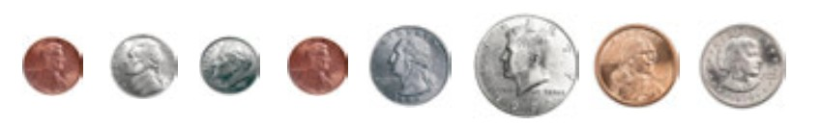
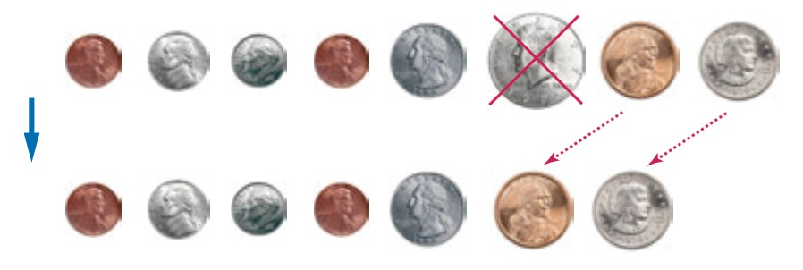
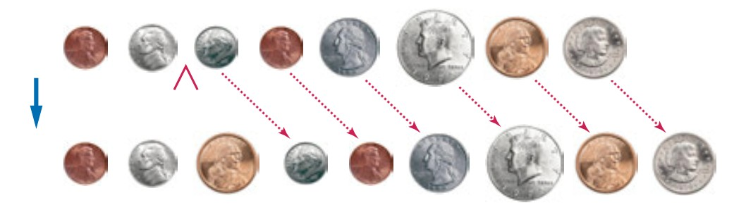
Problem Solving: Discovering Algorithms by Manipulating Physical Objects
Use a sequence of coins, playing cards, or toys to visualize an array of values. Original line of coins
Removal of an array element
Insertion of an array element
(coins) © james benet/iStockPhoto; (dollar coins) © Jordi Delgado/iStockPhoto.

Slide 66
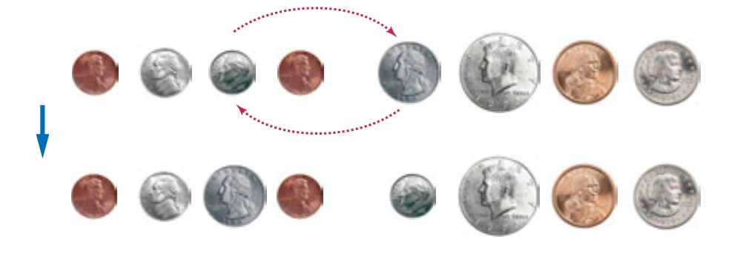
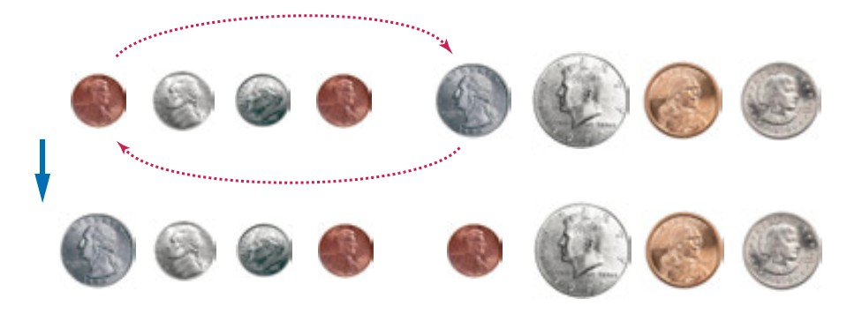
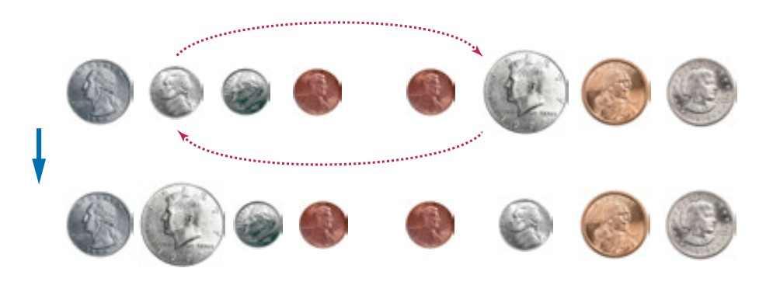
Problem Solving: Discovering Algorithms by Manipulating Physical Objects
Swapping array elements
Swap the coins in positions 0 and 4:
Swap the coins in positions 1 and 5:
(coins) © james benet/iStockPhoto; (dollar coins) © Jordi Delgado/iStockPhoto.

Slide 67
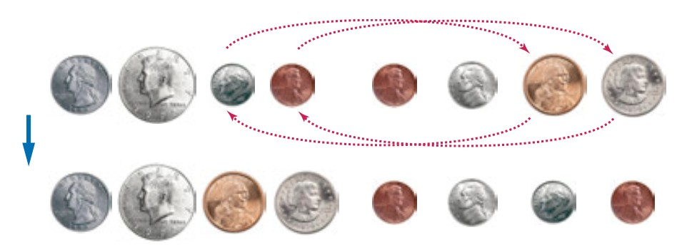
Problem Solving: Discovering Algorithms by Manipulating Physical Objects
Two more swaps
(coins) © james benet/iStockPhoto; (dollar coins) © Jordi Delgado/iStockPhoto.
The pseudocode
i = 0
j = size / 2
While (i < size / 2)
Swap elements at positions i and j i++
j++

Slide 68
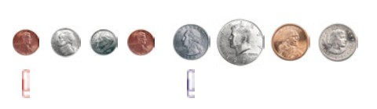
Self Check 7.25
Walk through the algorithm that we developed in this section, using two paper clips to indicate the positions for i and j. Explain why there are no bounds errors in the pseudocode.
Answer: The paperclip for i assumes positions 0, 1, 2, 3. When i is incremented to 4, the condition i < size / 2 becomes false, and the loop ends. Similarly, the paperclip for j assumes positions 4, 5, 6, 7, which are the valid positions for the second half of the array.
(coins) © james benet/iStockPhoto; (dollar coins) © Jordi Delgado/iStockPhoto.

Slide 69
Self Check 7.26
Take out some coins and simulate the following pseudocode, using two paper clips to indicate the positions for i and j.
i = 0
j = size - 1 While (i < j)
Swap elements at positions i and j i++
j--
What does the algorithm do?
Answer: It reverses the elements in the array.

Slide 70
Self Check 7.27
Consider the task of rearranging all elements in an array so that the even numbers come first. Otherwise, the order doesn’t matter. For example, the array
1 4 14 2 1 3 5 6 23
could be rearranged to 4 2 14 6 1 5 3 23 1
Using coins and paperclips, discover an algorithm that solves this task by swapping elements, then describe it in pseudocode.
Answer: Here is one solution. The basic idea is to move all odd elements to the end. Put one paper clip at the beginning of the array and one at the end. If the element at the first paper clip is odd, swap it with the one at the other paper clip and move that paper clip to the left. Otherwise, move the first paper clip to the right. Stop when the two paper clips meet. Here is the pseudocode:
i = 0
j = size - 1 While (i < j)
If (a[i] is odd)
Swap elements at positions i and j. j--
Else i++

Slide 71
Self Check 7.28
Discover an algorithm for the task of Self Check 27 that uses removal and insertion of elements instead of swapping.
Answer: Here is one solution. The idea is to remove all odd elements and move them to the end. The trick is to know when to stop. Nothing is gained by moving odd elements into the area that already contains moved elements, so we want to mark that area with another paper clip.
i = 0
moved = size While (i < moved)
If (a[i] is odd)
Remove the element at position i and add it at the end. moved--

Slide 72

Self Check 7.29
Consider the algorithm in Section 6.7.5 that finds the largest element in a sequence of inputs—not the largest element in an array. Why is this algorithm better visualized by picking playing cards from a deck rather than arranging toy soldiers in a sequence?
Answer: When you read inputs, you get to see values one at a time, and you can’t peek ahead. Picking cards one at a time from a deck of cards simulates this process better than looking at a sequence of items, all of which are revealed.

Slide 73
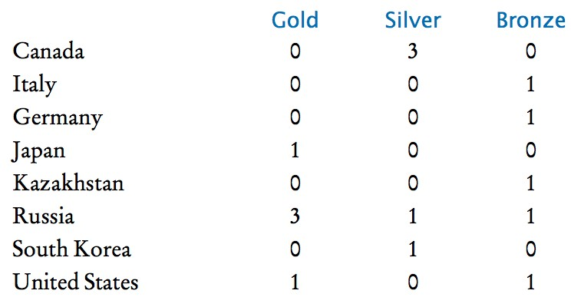
Two-Dimensional Arrays
An arrangement consisting of rows and columns of values
Also called a matrix.
Example: medal counts of the figure skating competitions at the 2014 Winter Olympics.
Figure 13 Figure Skating Medal Counts
Use a two-dimensional array to store tabular data.
When constructing a two-dimensional array, specify how many rows and columns are needed:
final int COUNTRIES = 8; final int MEDALS = 3;
int[][] counts = new int[COUNTRIES][MEDALS];

Slide 74
Two-Dimensional Arrays
You can declare and initialize the array by grouping each row:
int[][] counts =
{
{ 0, 3, 0 },
{ 0, 0, 1 },
{ 0, 0, 1 },
{ 1, 0, 0 },
{ 0, 0, 1 },
{ 3, 1, 1 },
{ 0, 1, 0 },
{ 1, 0, 1 }
};
You cannot change the size of a two-dimensional array once it has been declared.

Slide 75
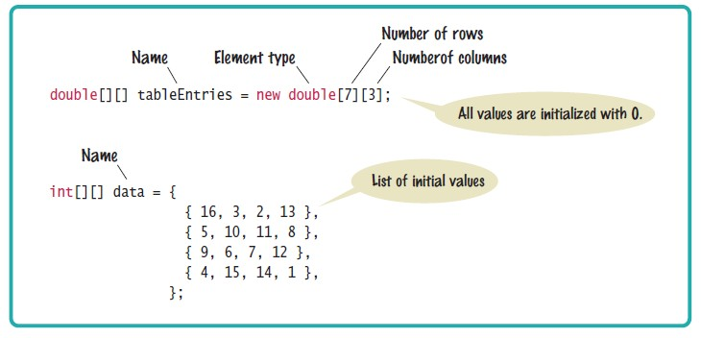
Syntax 7.3 Two-Dimensional Array Declaration

Slide 76
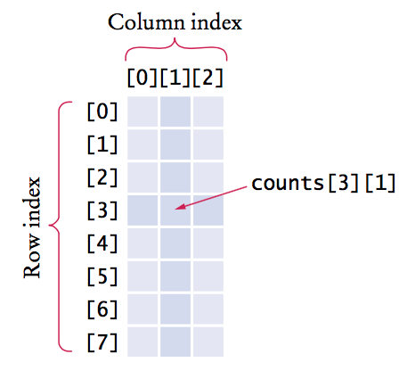
Accessing Elements
Access by using two index values, array[i][j]
int medalCount = counts[3][1];
Use nested loops to access all elements in a two-dimensional array. Example: print all the elements of the counts array
for (int i = 0; i < COUNTRIES; i++)
{
// Process the ith row
for (int j = 0; j < MEDALS; j++)
{
// Process the jth column in the ith row System.out.printf("%8d", counts[i][j]);
}
System.out.println(); // Start a new line at the end of the row
}
Figure 14 Accessing an Element in a Two-Dimensional Array

Slide 77
Accessing Elements
Number of rows: counts.length
Number of columns: counts[0].length
Example: print all the elements of the counts array
for (int i = 0; i < counts.length; i++)
{
for (int j = 0; j < counts[0].length; j++)
{
System.out.printf("%8d", counts[i][j]);
}
System.out.println();
}

Slide 78
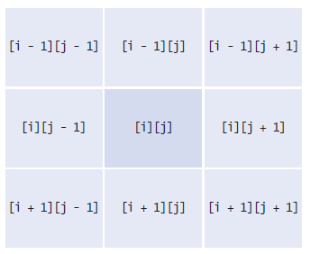
Locating Neighboring Elements
Figure 15 Neighboring Locations in a Two-Dimensional Array
Watch out for elements at the boundary array
counts[0][1] does not have a neighbor to the top

Slide 79
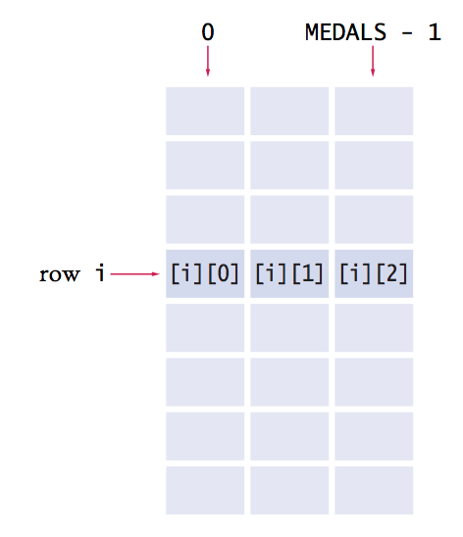
Accessing Rows and Columns
Problem: To find the number of medals won by a country
Find the sum of the elements in a row
To find the sum of the i^{th} row
compute the sum of counts[i][j], where j ranges from 0 to MEDALS - 1.
Loop to compute the sum of the i^{th} row
int total = 0;
for (int j = 0; j < MEDALS; j++)
{
total = total + counts[i][j];
}

Slide 80
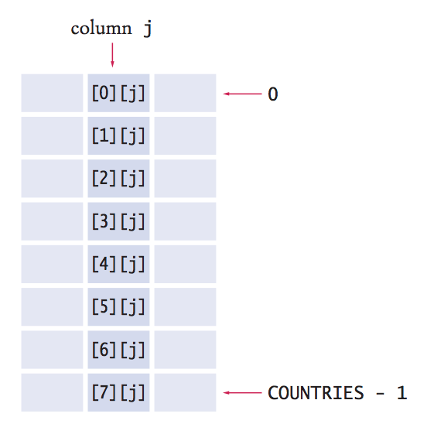
Accessing Rows and Columns
To find the sum of the j^{th} column
Form the sum of counts[i][j], where i ranges from 0 to COUNTRIES - 1
int total = 0;
for (int i = 0; i < COUNTRIES; i++)
{
total = total + counts[i][j];
}

Slide 81
section_6/Medals.java
1 /**
2 This program prints a table of medal winner counts with row totals.
3 */
4 public class Medals
5 {
6 public static void main(String[] args)
7 {
final int COUNTRIES = 8;
final int MEDALS = 3;
10
11
12
13
14
15
16
17
18
19
20
21
22
23
24
25
26
27
28
29
30
31
32
33
34
35
36
37
38
String[] countries =
{
"Canada",
"Italy", "Germany", "Japan", "Kazakhstan", "Russia", "South Korea", "United States"
};
int[][] counts =
{
{ 0, 3, 0 },
{ 0, 0, 1 },
{ 0, 0, 1 },
{ 1, 0, 0 },
{ 0, 0, 1 },
{ 0, 1, 0 },
{ 0, 1, 0 },
{ 1, 0, 1 }
};
System.out.println(" Country
Gold
Silver Bronze Total");
// Print countries, counts, and row totals
for (int i = 0; i < COUNTRIES; i++)

Slide 82
Program Run:
Country | Gold | Silver | Bronze | Total
Canada | 0 | 3 | 0 | 3
Italy | 0 | 0 | 1 | 1
Germany | 0 | 0 | 1 | 1
Japan | 1 | 0 | 0 | 1
Kazakhstan | 0 | 0 | 1 | 1
Russia | 3 | 1 | 1 | 5
South Korea | 0 | 1 | 0 | 1
United States | 1 | 0 | 1 | 2

Slide 83
Self Check 7.30
What results do you get if you total the columns in our sample data?
Answer: You get the total number of gold, silver, and bronze medals in the competition. In our example, there are five of each.

Slide 84
Self Check 7.31
Consider an 8 × 8 array for a board game:
int[][] board = new int[8][8];
Using two nested loops, initialize the board so that zeros and ones alternate, as on a checkerboard:
0 1 0 1 0 1 0 1
1 0 1 0 1 0 1 0
0 1 0 1 0 1 0 1
. . .
1 0 1 0 1 0 1 0
Hint: Check whether i + j is even.
Answer:
for (int i = 0; i < 8; i++)
{
for (int j = 0; j < 8; j++)
{
board[i][j] = (i + j) % 2;
}
}

Slide 85
Self Check 7.32
Declare a two-dimensional array for representing a tic-tac-toe board. The board has three rows and columns and contains strings "x", "o", and " ".
Answer: String[][] board = new String[3][3];

Slide 86
Self Check 7.33
Write an assignment statement to place an "x" in the upper-right corner of the tic-tac-toe board in Self Check 32.
Answer: board[0][2] = "x";

Slide 87
Self Check 7.34
Which elements are on the diagonal joining the upper-left and the lower-right corners of the tic-tac-toe board in Self Check 32?
Answer: board[0][0], board[1][1], board[2][2]

Slide 88

Array Lists
An array list stores a sequence of values whose size can change. An array list can grow and shrink as needed.
ArrayList class supplies methods for many common tasks, such as inserting and removing elements.
An array list expands to hold as many elements as needed.

Slide 89
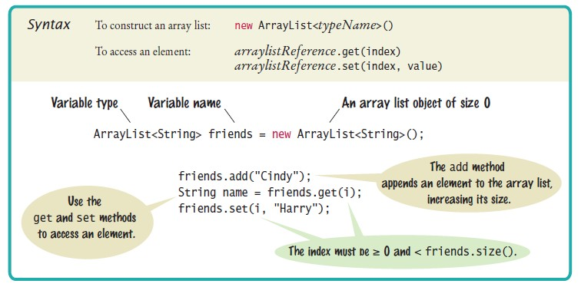
Syntax 7.4 Array Lists

Slide 90
Declaring and Using Array Lists
To declare an array list of strings
ArrayList<String> names = new ArrayList<String>();
To use an array list
import java.util.ArrayList;
ArrayList is a generic class
Angle brackets denote a type parameter
Replace String with any other class to get a different array list type

Slide 91
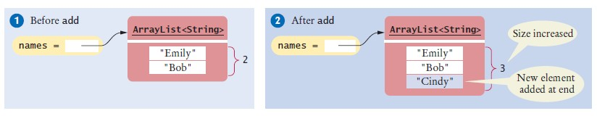
Declaring and Using Array Lists
ArrayList<String> is first constructed, it has size 0
Use the add method to add an object to the end of the array list:
names.add("Emily"); // Now names has size 1 and element "Emily" names.add("Bob"); // Now names has size 2 and elements "Emily", "Bob" names.add("Cindy"); // names has size 3 and elements "Emily", "Bob", and "Cindy"
The size method gives the current size of the array list.
Size is now 3
Figure 17 Adding an Array List Element with add

Slide 92
Declaring and Using Array Lists
To obtain an array list element, use the get method
Index starts at 0
To retrieve the name with index 2:
String name = names.get(2); // Gets the third element of the array list
The last valid index is names.size() - 1
A common bounds error:
int i = names.size();
name = names.get(i); // Error
To set an array list element to a new value, use the set method:
names.set(2, "Carolyn");

Slide 93

Declaring and Using Array Lists
An array list has methods for adding and removing elements in the middle.
This statement adds a new element at position 1 and moves all elements with index 1 or larger by one position.
names.add(1, "Ann")
The remove method,
removes the element at a given position
moves all elements after the removed element down by one position and reduces the size of the array list by 1.
names.remove(1);
To print an array list:
System.out.println(names); // Prints [Emily, Bob, Carolyn]

Slide 94
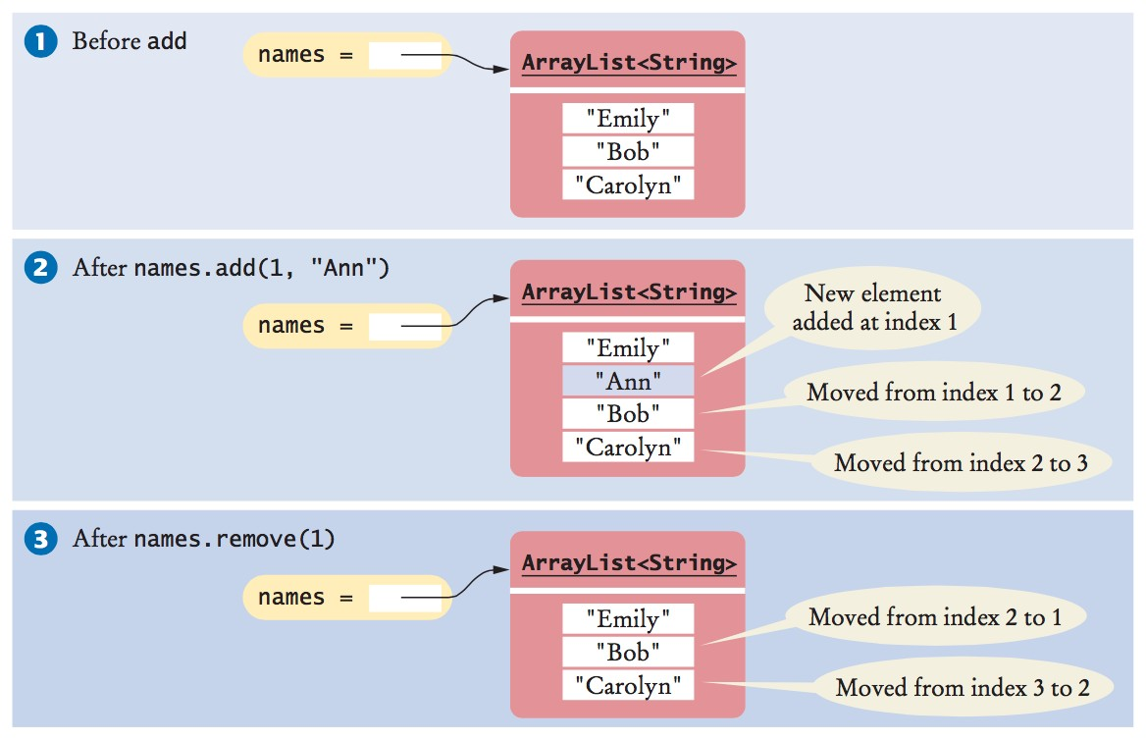
Declaring and Using Array Lists
Figure 18 Adding and Removing Elements in the Middle of an Array List

Slide 95
Using the Enhanced for Loop with Array Lists
You can use the enhanced for loop to visit all the elements of an array list
ArrayList<String> names = . . . ; for (String name : names)
{
System.out.println(name);
}
This is equivalent to:
for (int i = 0; i < names.size(); i++)
{
String name = names.get(i); System.out.println(name);
}

Slide 96
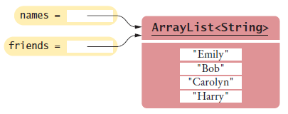
Copying Array Lists
Copying an array list reference yields two references to the same array list. After the code below is executed
Both names and friends reference the same array list to which the string "Harry" was added.
ArrayList<String> friends = names; friends.add("Harry");
Figure 19 Copying an Array List Reference
To make a copy of an array list, construct the copy and pass the original list into the constructor:
ArrayList<String> newNames = new ArrayList<String>(names);

Slide 97
Working with Array Lists
ArrayList<String> names = new ArrayList<String>();
Constructs an empty array list that can hold strings.
names.add("Ann");
names.add("Cindy");
Adds elements to the end.
System.out.println(names);
Prints [Ann, Cindy].
names.add(1, "Bob");
Inserts an element at index 1. names is now [Ann, Bob, Cindy].
names.remove(0);
Removes the element at index 0. names is now [Bob, Cindy].
names.set(0, "Bill");
Replaces an element with a different value. names is now [Bill, Cindy].
String name = names.get(i);
Gets an element.
String last = names.get(names.size() - 1);
Gets the last element.
ArrayList<Integer> squares = new ArrayList<Integer>(); for (int i = 0; i < 10; i++)
{
squares.add(i * i);
}
Constructs an array list holding the first ten squares.

Slide 98

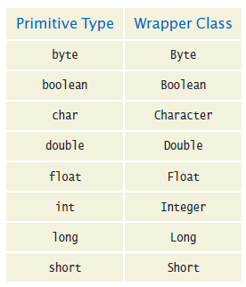
Wrapper Classes
You cannot directly insert primitive type values into array lists.
Like truffles that must be in a wrapper to be sold, a number must be placed in a wrapper to be stored in an array list.
Use the matching wrapper class.

Slide 99
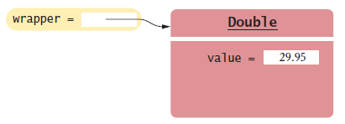
Wrapper Classes
To collect double values in an array list, you use an ArrayList<Double>.
if you assign a double value to a Double variable, the number is automatically “put into a box”
Called auto-boxing:
Automatic conversion between primitive types and the corresponding wrapper classes:
Double wrapper = 29.95;
Wrapper values are automatically “unboxed” to primitive types
double x = wrapper;
Figure 20 A Wrapper Class Variable

Slide 100
Using Array Algorithms with Array Lists
The array algorithms can be converted to array lists simply by using the array list methods instead of the array syntax.
Code to find the largest element in an array:
double largest = values[0];
for (int i = 1; i < values.length; i++)
{
if (values[i] > largest)
{
largest = values[i];
}
}
Code to find the largest element in an array list
double largest = values.get(0);
for (int i = 1; i < values.size(); i++)
{
if (values.get(i) > largest)
{
largest = values.get(i);
}
}

Slide 101
Storing Input Values in an Array List
To collect an unknown number of inputs, array lists are much easier to use than arrays.
Simply read the inputs and add them to an array list:
ArrayList<Double> inputs = new ArrayList<Double>(); while (in.hasNextDouble())
{
inputs.add(in.nextDouble());
}

Slide 102
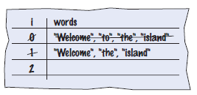
Removing Matches
To remove elements from an array list, call the remove method. Error: skips the element after the moved element
ArrayList<String> words = ...;
for (int i = 0; i < words.size(); i++)
{
String word = words.get(i); if (word.length() < 4)
{
Remove the element at index i.
}
}
Concrete example
Should not increment i when an element is removed

Slide 103
Removing Matches
Pseudocode
If the element at index i matches the condition Remove the element.
Else Increment i.
Use a while loop, not a for loop
int i = 0;
while (i < words.size())
{
String word = words.get(i); if (word.length() < 4)
{
words.remove(i);
}
else
{
i++;
}
}

Slide 104
Choosing Between Array Lists and Arrays
For most programming tasks, array lists are easier to use than arrays
Array lists can grow and shrink. Arrays have a nicer syntax.
Recommendations
If the size of a collection never changes, use an array.
If you collect a long sequence of primitive type values and you are concerned about efficiency, use an array.
Otherwise, use an array list.

Slide 105
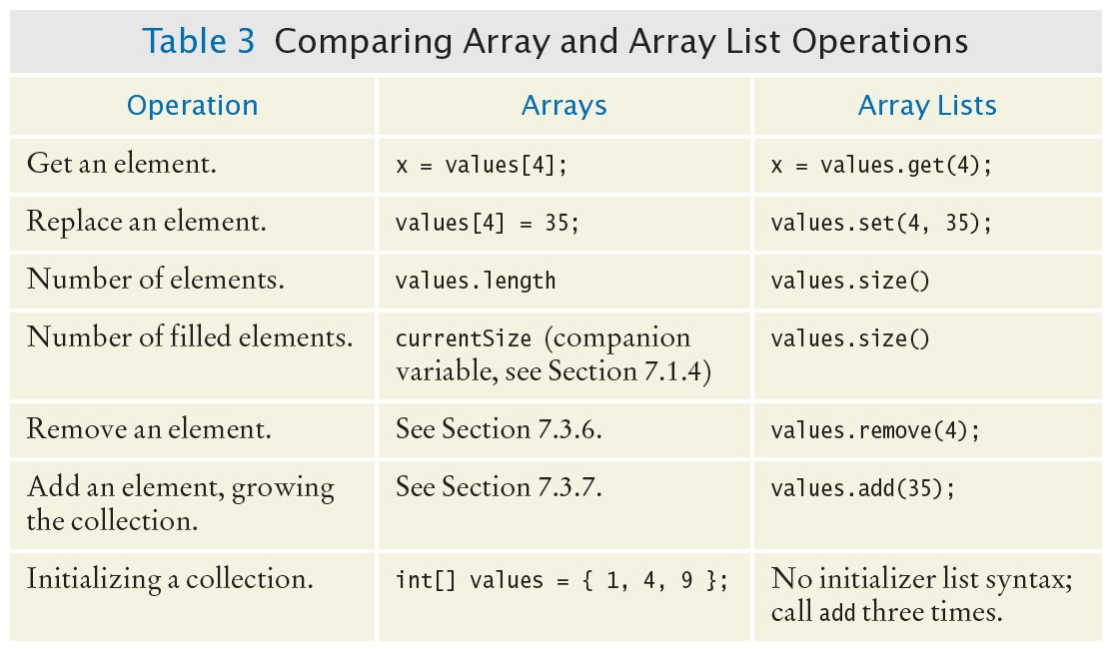
Choosing Between Array Lists and Arrays

Slide 106
section_7/LargestInArrayList.java
import java.util.ArrayList;
import java.util.Scanner;
3
4 /**
5 This program reads a sequence of values and prints them, marking the largest value.
6 */
7 public class LargestInArrayList
8 {
9 public static void main(String[] args)
10 {
11 ArrayList<Double> values = new ArrayList<Double>();
12
13
14
15
16
17
18
19
20
21
22
23
24
25
26
27
28
29
30
31
32
33
34
35
// Read inputs
System.out.println("Please enter values, Q to quit:"); Scanner in = new Scanner(System.in);
while (in.hasNextDouble())
{
values.add(in.nextDouble());
}
// Find the largest value
double largest = values.get(0);
for (int i = 1; i < values.size(); i++)
{
if (values.get(i) > largest)
{
largest = values.get(i);
}
}
// Print all values, marking the largest
for (double element : values)
Program Run:
Please enter values, Q to quit: 35 80 115 44.5 Q
35 80
115 <== largest value
44.5

Slide 107
Self Check 7.35
Declare an array list primes of integers that contains the first five prime numbers (2, 3, 5, 7, and 11).
Answer:
ArrayList<Integer> primes = new ArrayList<Integer>(); primes.add(2);
primes.add(3); primes.add(5); primes.add(7); primes.add(11);

Slide 108
Self Check 7.36
Given the array list primes declared in Self Check 35, write a loop to print its elements in reverse order, starting with the last element.
Answer:
for (int i = primes.size() - 1; i >= 0; i--)
{
System.out.println(primes.get(i));
}

Slide 109
Self Check 7.37
What does the array list names contain after the following statements?
ArrayList<String> names = new ArrayList<String>; names.add("Bob");
names.add(0, "Ann"); names.remove(1); names.add("Cal");
Answer: "Ann", "Cal"

Slide 110
Self Check 7.38
What is wrong with this code snippet?
ArrayList<String> names; names.add(Bob);
Answer: The names variable has not been initialized.

Slide 111
Self Check 7.39
Consider this method that appends the elements of one array list to another:
public void append(ArrayList<String> target, ArrayList<String> source)
{
for (int i = 0; i < source.size(); i++)
{
target.add(source.get(i));
}
}
What are the contents of names1 and names2 after these statements?
ArrayList<String> names1 = new ArrayList<String>(); names1.add("Emily");
names1.add("Bob"); names1.add("Cindy");
ArrayList<String> names2 = new ArrayList<String>(); names2.add("Dave");
append(names1, names2);
Answer: names1 contains "Emily", "Bob", "Cindy", "Dave"; names2
contains "Dave"

Slide 112
Self Check 7.40
Suppose you want to store the names of the weekdays. Should you use an array list or an array of seven strings?
Answer: Because the number of weekdays doesn’t change, there is no disadvantage to using an array, and it is easier to initialize:
String[] weekdayNames = { "Monday", "Tuesday", "Wednesday", "Thursday", “Friday”, "Saturday", "Sunday" };

Slide 113
Self Check 7.41
The ch07/section_7 directory of your source code contains an alternate implementation of the problem solution in How To 7.1 on page 330. Compare the array and array list implementations. What is the primary advantage of the latter?
Answer: Reading inputs into an array list is much easier.

Slide 114
Regression Testing
Test suite: a set of tests for repeated testing
Cycling: bug that is fixed but reappears in later versions
Regression testing: involves repeating previously run tests to ensure that known failures of prior versions do not appear in new versions

Slide 115
Regression Testing - Two Approaches
Organize a suite of test with multiple tester classes: ScoreTester1, ScoreTester2, ...
public class ScoreTester1
{
public static void main(String[] args)
{
Student fred = new Student(100); fred.addScore(10); fred.addScore(20); fred.addScore(5);
System.out.println("Final score: " + fred.finalScore()); System.out.println("Expected: 30");
}
}
Provide a generic tester, and feed it inputs from multiple files.

Slide 116
section_8/ScoreTester.java
Generic tester:
1 import java.util.Scanner;
2
3 public class ScoreTester
4 {
5 public static void main(String[] args)
6 {
Scanner in = new Scanner(System.in);
double expected = in.nextDouble();
Student fred = new Student(100);
while (in.hasNextDouble())
11 {
12 if (!fred.addScore(in.nextDouble()))
13 {
System.out.println("Too many scores.");
return;
16 }
17 }
System.out.println("Final score: " + fred.finalScore());
System.out.println("Expected: " + expected);
20 }
21 }

Slide 117
Input and Output Redirection
Section_8/input1.txt
30
10
20
5
Type the following command into a shell window
Input redirection
java ScoreTester < input1.txt
Program Run:
Final score: 30
Expected: 30
Output redirection:
java ScoreTester < input1.txt > output1.txt

Slide 118
Self Check 7.42
Suppose you modified the code for a method. Why do you want to repeat tests that already passed with the previous version of the code?
Answer: It is possible to introduce errors when modifying code.

Slide 119
Self Check 7.43
Suppose a customer of your program finds an error. What action should you take beyond fixing the error?
Answer: Add a test case to the test suite that verifies that the error is fixed.

Slide 120
Self Check 7.44
Why doesn't the ScoreTester program contain prompts for the inputs?
Answer: There is no human user who would see the prompts because input is provided from a file.

